Slide 1
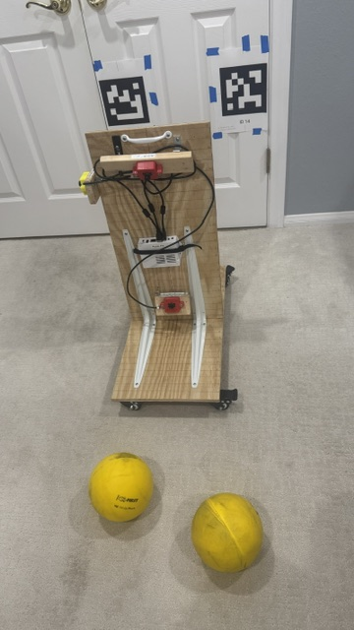
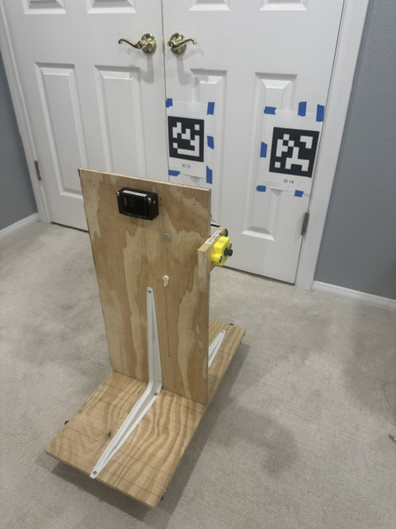
#13
#14
April
tags
USB #1
Rubik
USB #2
BACK
Limelight
FRONT
USB #3
Fuel

